Slide 1

ShowLens: Show Insights, Predictions & Recommendations
This project applies a data scientist's mindset to a Shows dataset, exploring patterns, generating actionable insights, and applying predictive techniques.
It combines Exploratory Data Analysis (EDA), Predictive Modeling, and a Content-Based Recommendation System to uncover trends and help users discover new shows. The goal is to provide insights useful for viewers, content creators, and producers.

Slide 2

Unveiling Show Trends: Our Research Questions
1
Highest Rated Shows
Which Shows are the highest rated of all time, by year, and in the most recent two years?
2
Genre & Actor Impact
Which genres and actors are featured in the highest-rated shows, and how do they influence show rankings?
3
Predictive & Recommendation Systems
Can we predict a show's rank based on its features? Can we recommend similar shows based on user preferences?

Slide 3

Data Preparation: From Raw to Ready
Initial Data Inspection
Data Cleaning & Insights
The dataset contained 350 entries with various details like Rank, Title, Year, Episodes, Rating, Description, Genre, Tags, and Actors. Initial inspection revealed that the 'Rank' column was stored as an object (string) and 'Tags' were not needed.
The 'Rank' column was cleaned by removing the '#' symbol and converting it to an integer. The 'Tags' column was dropped. No null values were found, ensuring data integrity. This step was crucial for accurate analysis and visualization.
The 'Year of release' column had some missing years, which was deemed acceptable for the analysis.

Slide 4
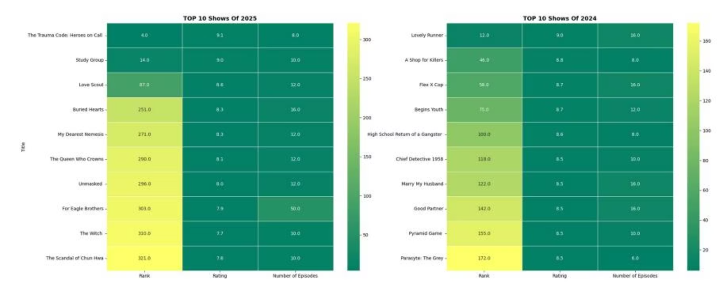
Top Shows: Recent & All-Time Favorites
The heatmap below highlights the Top 10 Shows from the past two years (2025 vs. 2024), comparing their Rank, Rating, and Number of Episodes.
The Top 3 Shows across both years combined are: The Trauma Code: Heroes on Call, Lovely Runner, and Study Group. All 11 top-rated Shows fall within a very high rating range of 9.1 to 9.2, indicating consistent excellence.

Slide 5
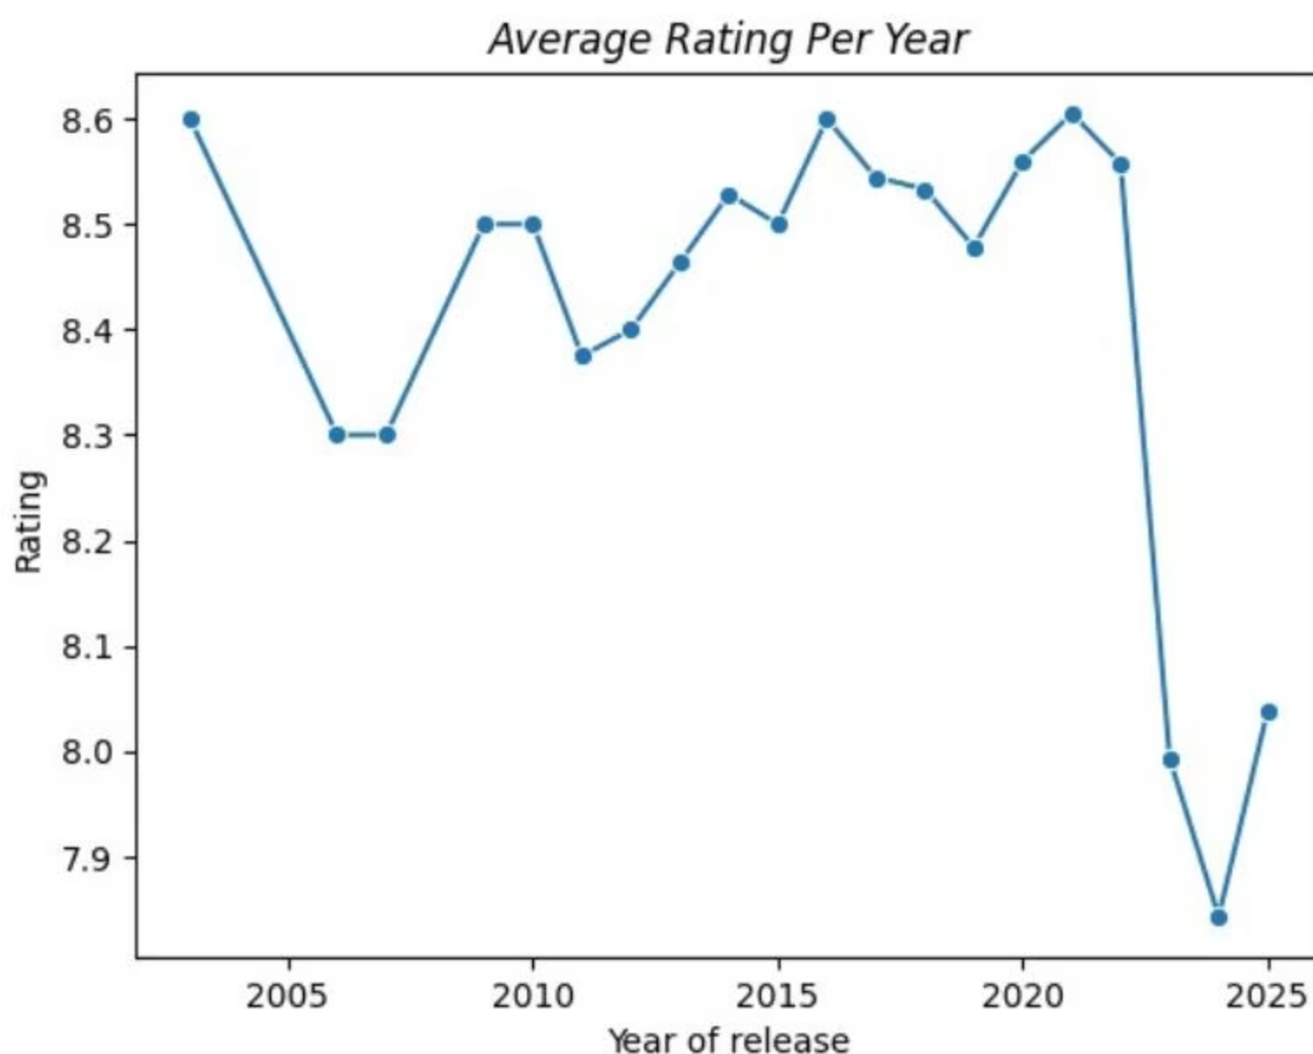
Show Rating Trends Over Time
The line plot illustrates the average Show ratings per year, revealing significant trends in audience reception.
Early Stability (2003–2010): Ratings fluctuated slightly, staying in the mid-8.3 to 8.6 range.
Strong Period (2013–2021): A consistent upward trend with peaks around 2016 and 2021 (≈8.6), indicating well-received Shows.
Sharp Decline (2022–2024): A noticeable drop after 2021, with ratings falling below 8.0 in 2024, the lowest in the dataset.
Partial Recovery (2025): A small rebound compared to 2024, but still below the 2016–2020 peak.

Slide 6

Dynamic Insights: Genre, Actor, and Year Analysis
To provide flexible exploration, utility functions were developed to filter and visualize data based on specific genres, actors, or release years. This modular design ensures robust analysis and allows users to explore Shows from various perspectives.
Top Shows by Genre
Top Shows by Actor
Top Shows by Year
Filters and visualizes top shows within a selected genre, helping viewers discover new favorites and providing insights for content creators.
Identifies and displays top shows featuring a specific actor, useful for fans and producers alike to see actor performance trends.
Showcases the highest-rated shows from a particular release year, highlighting annual trends and popular titles.

Slide 7
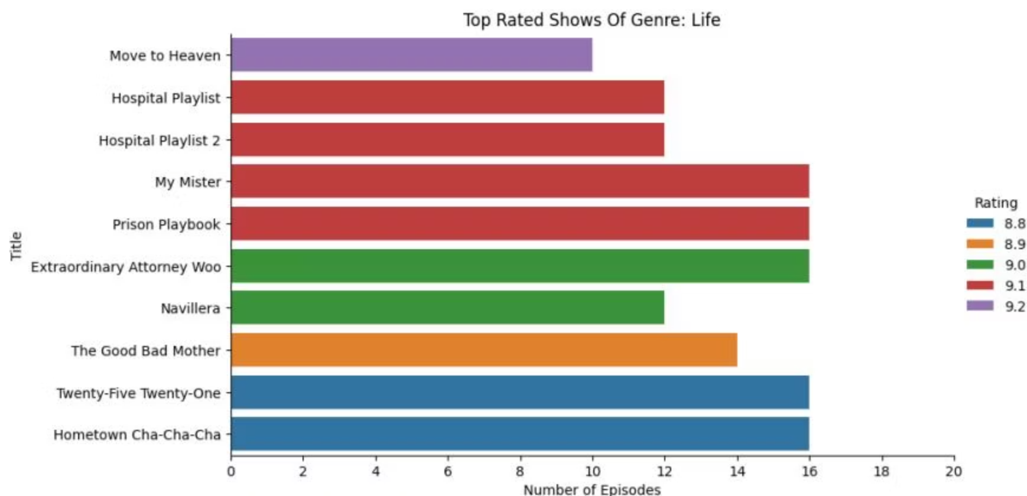
Genre Spotlight: Top Life Shows
The bar chart below highlights the Top 10 Life-genre shows based on their ratings and number of episodes. This provides valuable insights for viewers and content creators.
Ratings for Life-genre shows range between 8.8 and 9.2.
Move to Heaven leads with the highest rating (9.2).
Episode counts vary, indicating that high ratings are not strictly dependent on series length.

Slide 8
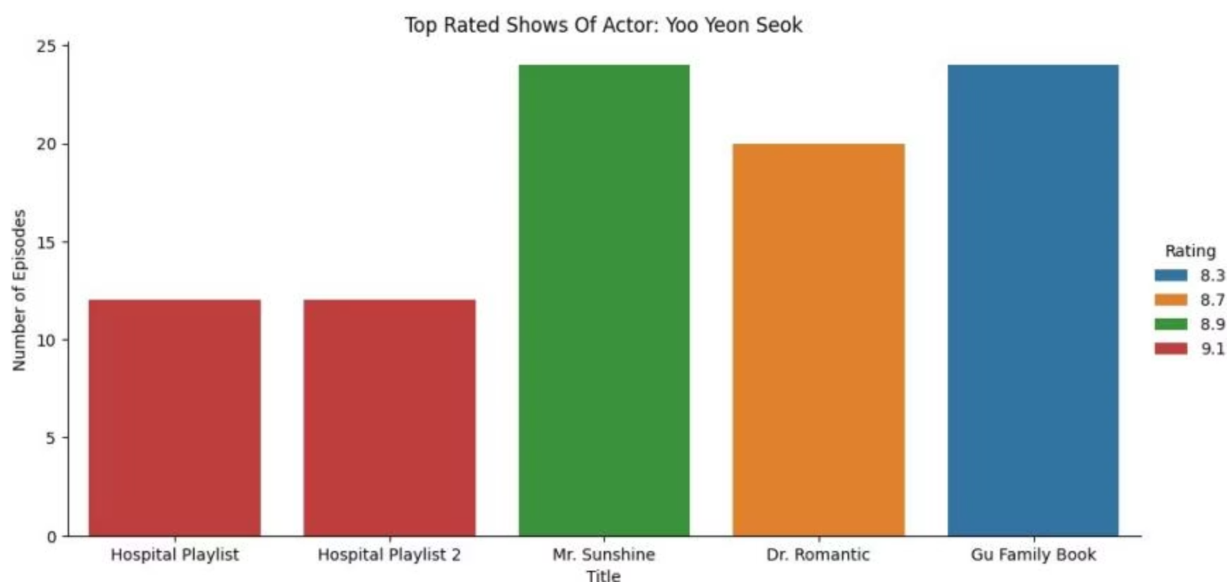
Actor Spotlight: Yoo Yeon Seok's Top Performances
This chart showcases the Top 5 Shows featuring actor Yoo Yeon Seok, based on their ratings and episode counts. This helps fans find his best work and offers insights into his consistent performance in highly-rated Shows.
Yoo Yeon Seok's Shows range in ratings from 8.3 to 9.1.
Hospital Playlist leads with the highest rating (9.1).
Episode counts vary, demonstrating that his strong performances are not tied to series length.

Slide 9
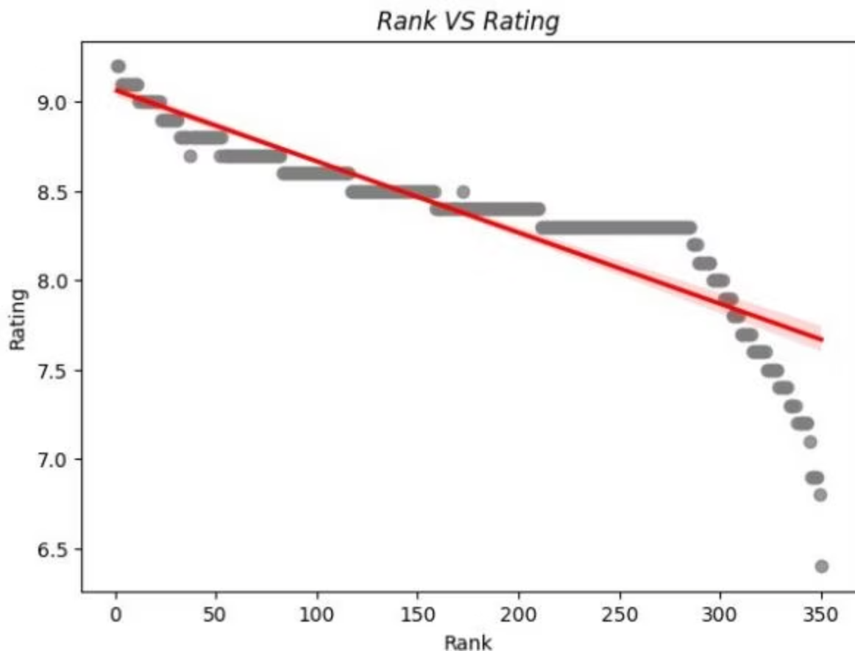
Predicting Success: Rank vs. Rating
There is a strong negative correlation between a show's Rank and Rating. As the rating increases, the rank value decreases (closer to Rank 1), meaning higher-rated shows achieve better ranks.
A linear regression model was built to predict a show's rank based on its rating, achieving an R² Score of 0.81 and an RMSE of 44.11. This confirms that ratings are a reliable predictor of rank, though additional features could enhance accuracy.
For a rating of 8.6, the predicted rank is approximately 130.7

Slide 10
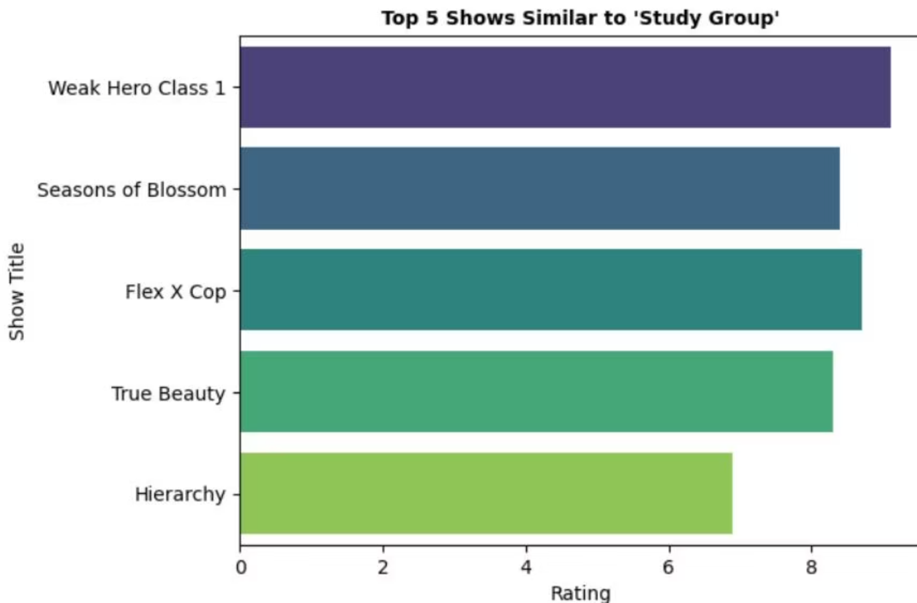
Personalized Recommendations: Discover Your Next Show
A content-based recommendation system was developed using TF-IDF vectorization of genres and actors, combined with cosine similarity. This system suggests Shows similar to a user's favorite titles, enhancing personalized viewing experiences.
For example, if you enjoyed 'Study Group', the system recommends:
Weak Hero Class 1 (~8.8 Rating)
Flex X Cop (~8.5 Rating)
Seasons of Blossom (~8.3 Rating)
True Beauty (~8.2 Rating)
Hierarchy (~6.8 Rating)

Slide 11
From Raw Data to Interactive Experience
A complete rebuild from the ground up—working with a much larger dataset filtered to the last 5 years, and redesigning the entire pipeline for scalability and user experience.
What started as a data challenge became a UI/UX challenge. The result: a Netflix-inspired Power BI dashboard that feels like a product, not a report.
Time invested: 8 hours
Approach: Blending data engineering, analytics, and designData Engineering: Building a Scalable Foundation
Data Cleaning & Standardization
Schema Design
Technical Implementation
Cleaned and standardized raw data using Python
Designed a star schema for scalable analysis
Built dimension tables for shows, writers, directors, genres
Handled complex string-based attributes (genres, writers, directors)
Separated fact and dimension tables
Created fact tables for ratings and metadata
Eliminated wide, unreadable columns
Normalized multi-valued columns using Power Query
Optimized for faster dashboard performance
Structured data for dynamic Power BI visuals
Ensured data integrity across 5-year filtered dataset
Enabled efficient filtering and aggregation

Slide 12
Turning Reports into Products
Key Design Decisions
Curated Show Posters
Dynamic Image URLs
Manually curated and aligned show posters for authentic streaming experience
Dynamic image URLs integrated into Power BI visuals
High-Resolution Images
Dynamic Details Page
Python function to upgrade low-resolution image URLs to original quality
Details page that dynamically updates with synopsis, images, and metadata
Result
A dashboard that feels like an interactive product, not a static report.

Slide 13

Dashboard Design: Home Page

Slide 14
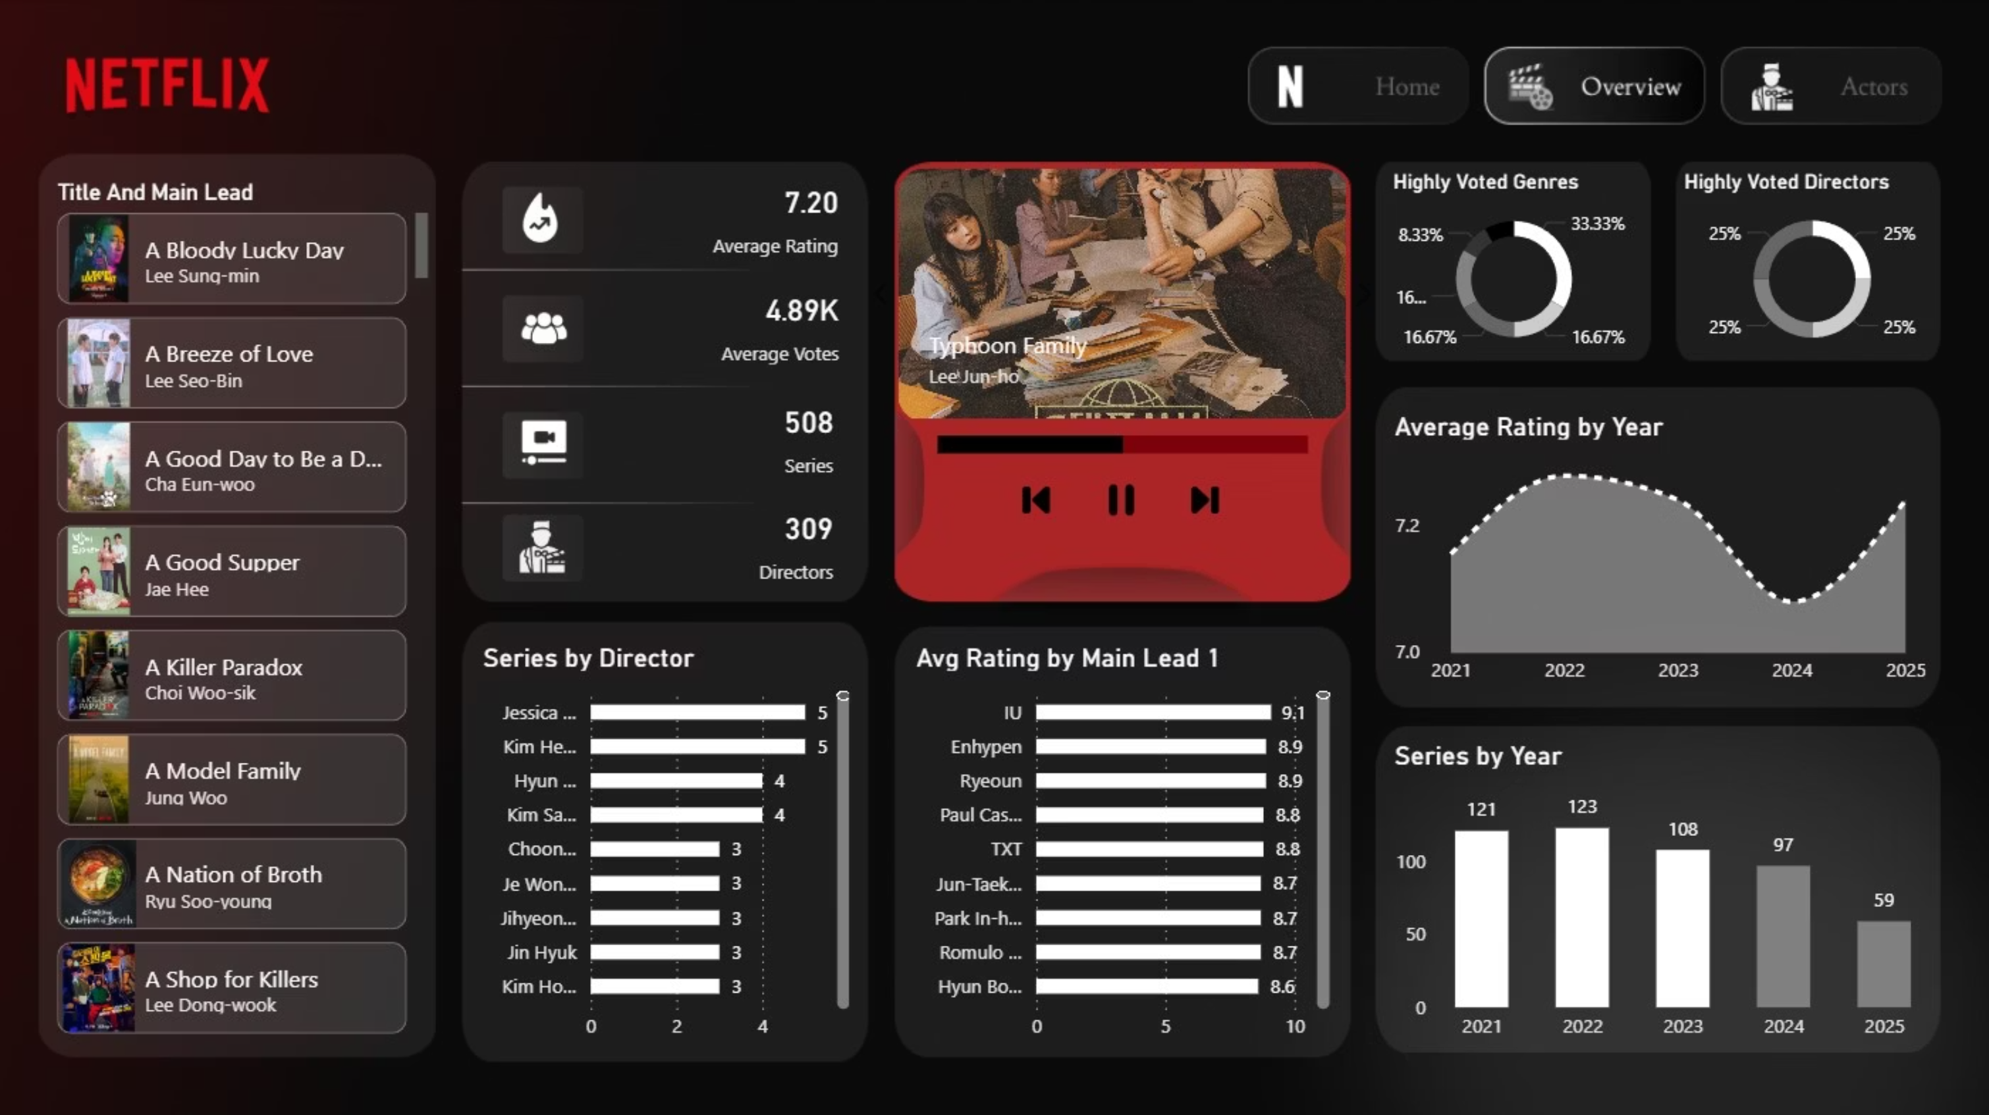
Dashboard Design: Overview Page

Slide 15
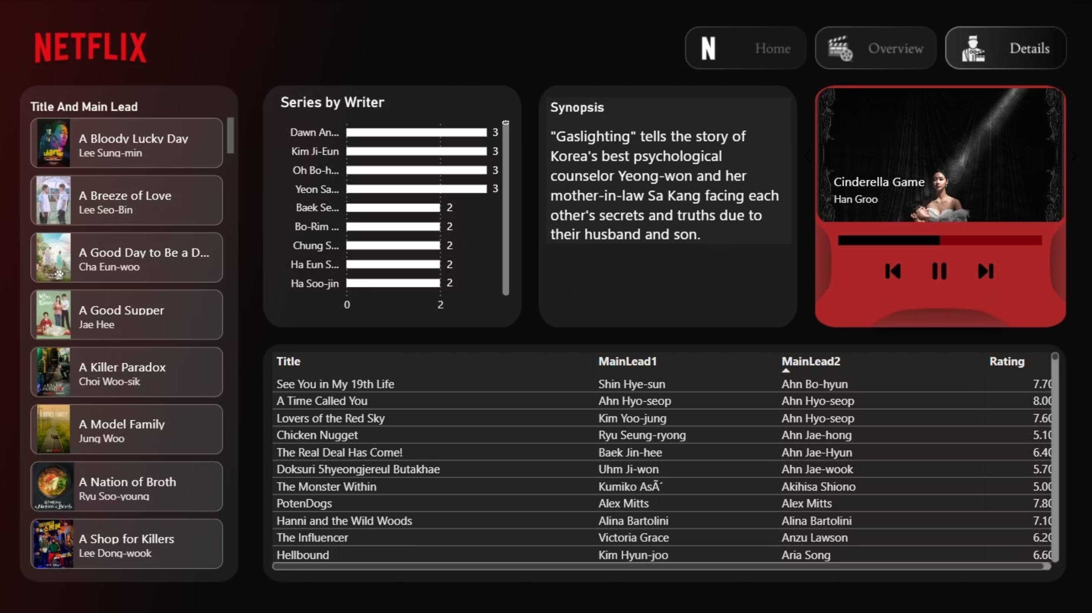
Dashboard Design: Details Page

